Slide 1
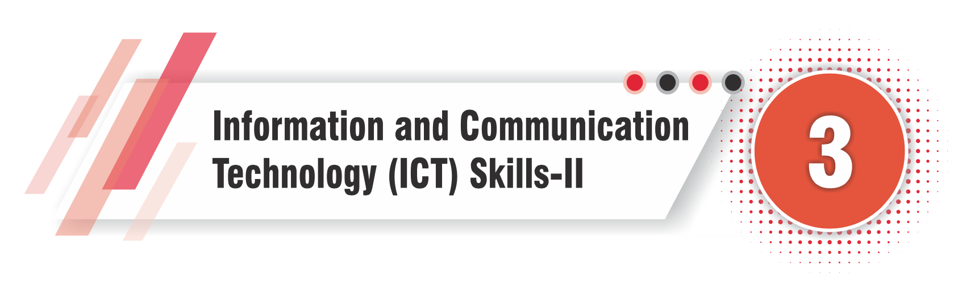
Class X

Slide 2
Contents
Operating System
Basic File or Folder Operations
Windows Desktop
Backup & Restore
Apply Basic Skills for care and Maintenance of Computer
Computer Security & Virus
Assignments
Quiz

Slide 3

Do Use Strong Passwords
Create complex passwords using a mix of letters, numbers, and symbols, and change them regularly.
Do Install Antivirus Software
Use and regularly update antivirus software to protect your computer from malware and viruses.
Do Keep Software Updated
Regularly update your operating system and all software to patch security vulnerabilities.
Do Backup Important Data
Regularly back up your important files to an external drive or cloud storage.
Do Be Careful with Emails
Be cautious about opening email attachments or clicking on links from unknown senders.
Do Use Two-Factor Authentication
Enable two-factor authentication for an extra layer of security on your accounts.
Do Log Out After Use
Log out of your accounts and shut down or lock your computer when not in use.
Do Use Secure Networks
Connect to secure and trusted Wi-Fi networks, especially when handling sensitive information.
Do Monitor Computer Usage
Keep track of your computer’s performance and any unusual behavior to detect potential issues early.
Do Learn Safe Browsing Habits
Visit reputable websites and avoid downloading files or software from untrusted sources.

Slide 4
Don’t Share Passwords
Never share your passwords with anyone, even friends or family.
Don’t Ignore Security Warnings
Pay attention to security warnings and messages from your antivirus software.
Don’t Click on Suspicious Links
Avoid clicking on links in emails, messages, or websites that seem suspicious or are from unknown sources.
Don’t Download Unverified Software
Only download software from official or trusted sources to avoid malware.
Don’t Use Public Wi-Fi for Sensitive Transactions
Avoid conducting sensitive activities like online banking on public Wi-Fi networks.
Don’t Disable Firewall and Security Settings
Keep your firewall and other security settings enabled for protection.
Don’t Ignore Software Updates
Don’t postpone or ignore updates for your operating system and applications.
Don’t Plug in Unknown USB Devices
Avoid using USB drives or other devices from unknown sources, as they may contain malware.
Don’t Leave Your Computer Unattended
Don’t leave your computer unattended and unlocked in public places.
Don’t Install Multiple Antivirus Programs
Installing more than one antivirus program can cause conflicts and reduce protection.

Slide 5
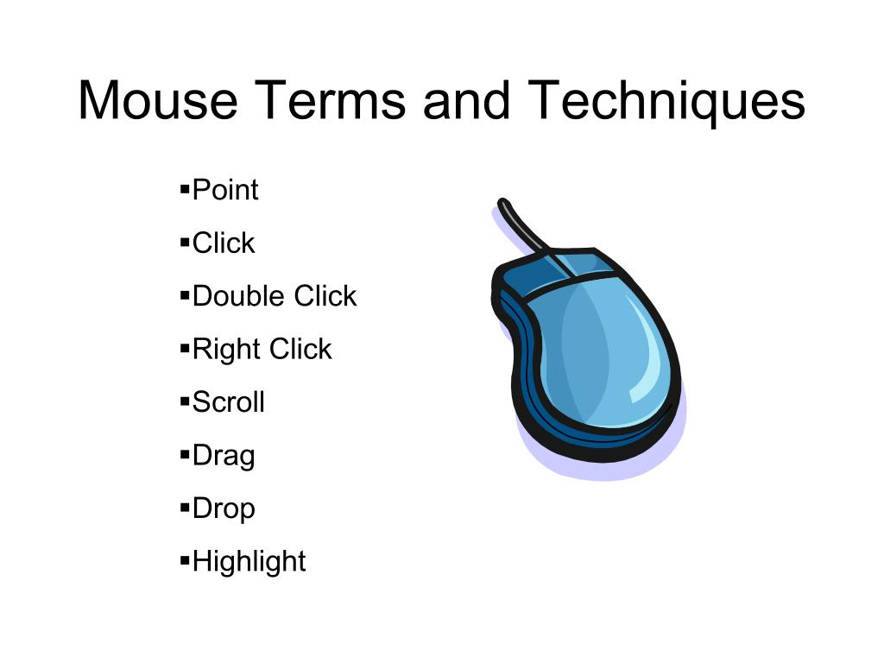
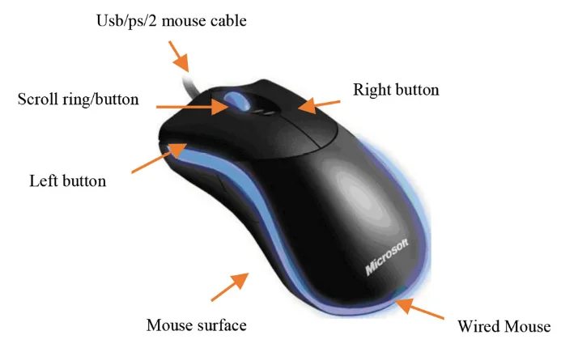

Slide 6
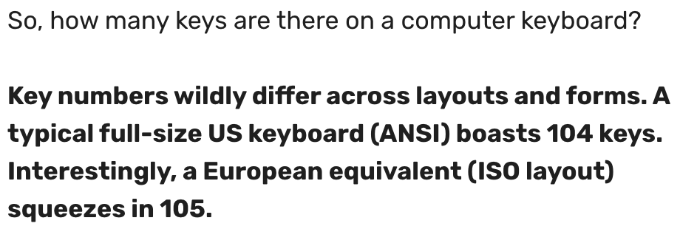
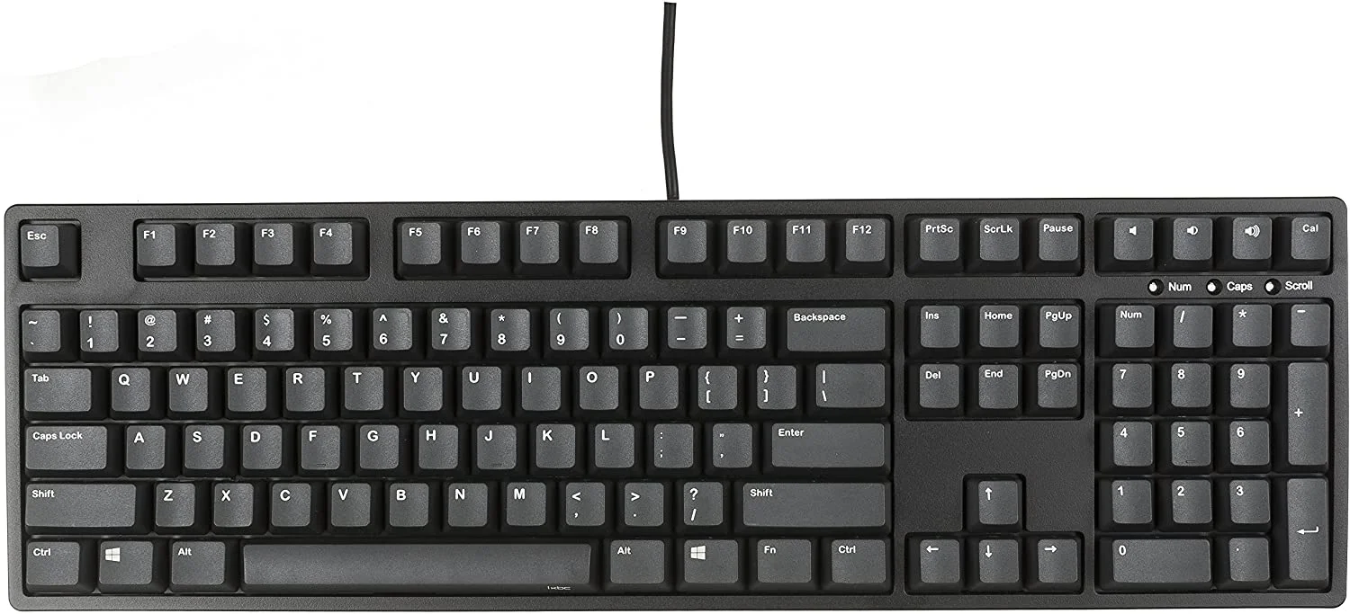
Standard Keyboard

Slide 7
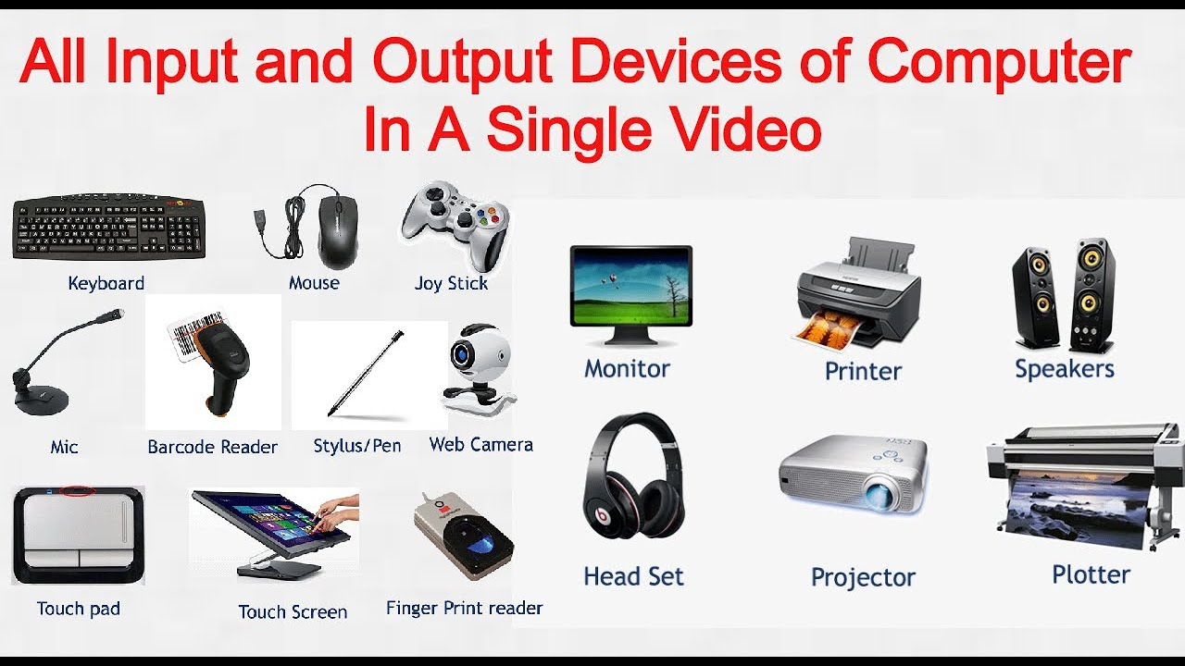
Standard Input/Output Devices

Slide 8
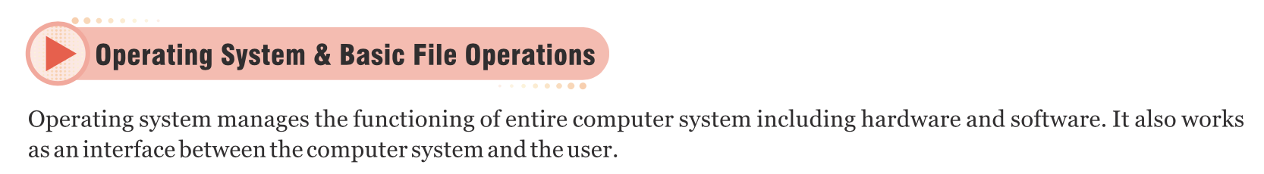
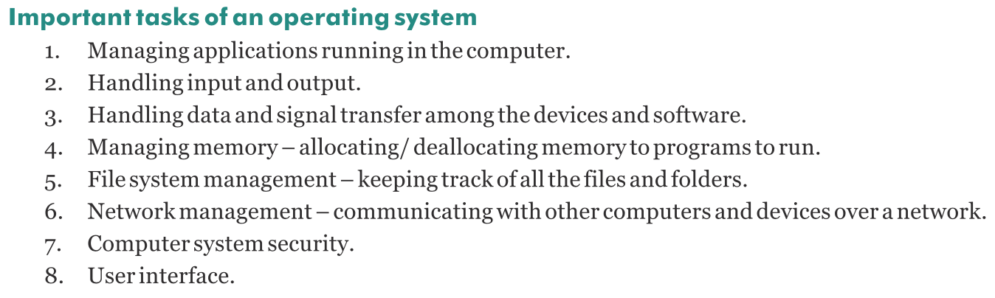

Slide 9
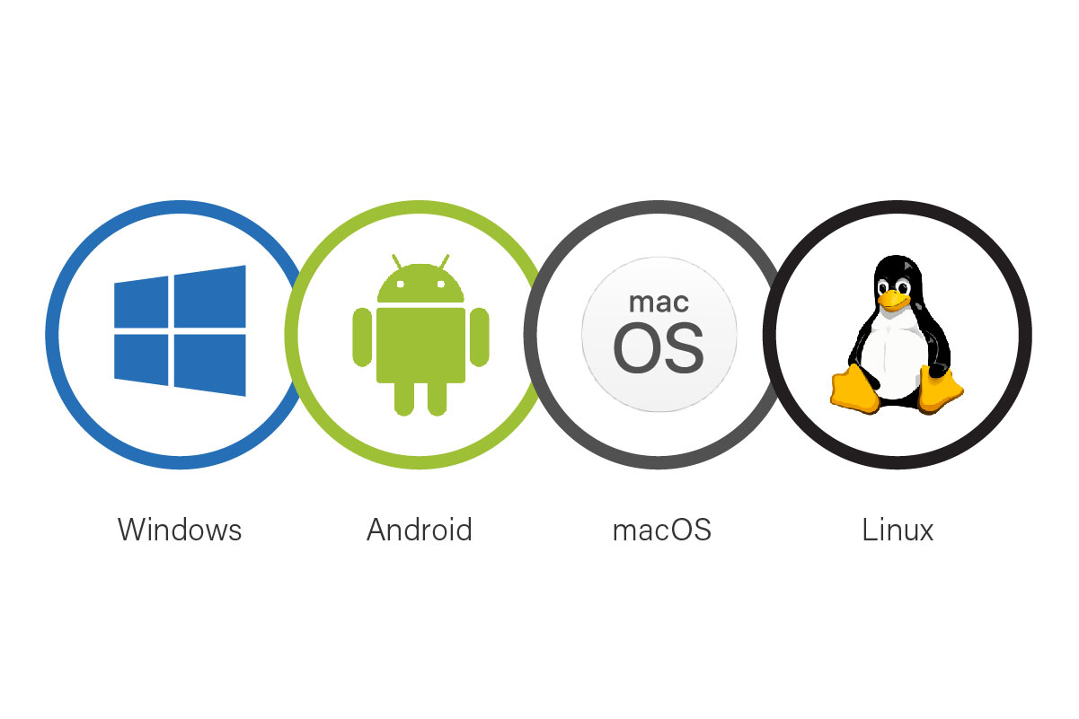
Single User OS
Description: A single user operating system is designed for one user at a time. It manages the computer so that one user can perform tasks such as running applications, saving files, and browsing the internet.
Examples:
Windows 10/11: Most versions are primarily used by individual users on personal computers.
macOS: Typically used by one user at a time on Mac computers.
Single-user mode in Linux: While Linux can be a multi-user OS, it can also be configured for single-user use on personal computers.

Slide 10
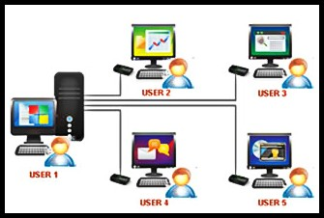
Multi-User OS
Description: A multi-user operating system allows multiple users to access the computer's resources simultaneously. It manages multiple user accounts, ensuring that each user can work independently without interfering with others.
Examples:
Linux: Many Linux distributions (like Ubuntu, Fedora) are designed to handle multiple users efficiently.
Unix: A powerful multi-user OS often used in servers and academic settings.
Windows Server: A version of Windows designed to manage multiple users, often used in network environments like schools or businesses.

Slide 11
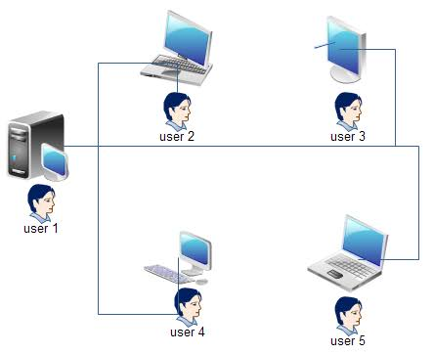
Advantages:
It helps in the sharing of data and information among different users.
It also helps in the sharing of hardware resources such as printers, scanners.
It avoids disruption if any one computer fails it does not affect any other computer present on that network.
Users can share their work with other users.
Disadvantages:
It requires expensive hardware to set up a mainframe computer
When multiple users log on or work on the same system it reduces the overall performance of the system.
Information is shared with the public so privacy becomes a concern here.

Slide 12
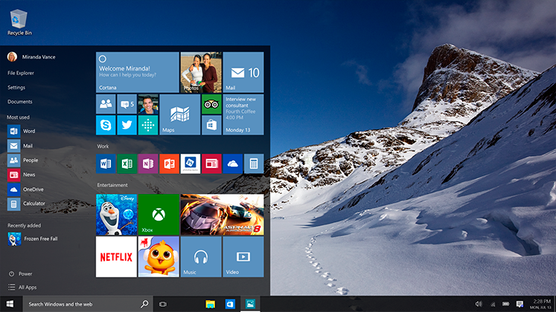
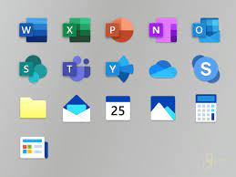
Windows Desktop Components
1. Wallpaper
Description: The wallpaper is the background image on your desktop.
Customization: You can choose from default wallpapers provided by Windows or set a personal photo or downloaded image as your wallpaper.
Function: It adds a personal touch to your desktop and can make it more visually appealing.
2. Icons
Description: Icons are small graphical representations of programs, files, or folders.
Types:
System Icons: Default icons such as "This PC," "Recycle Bin," and "Control Panel."
Shortcut Icons: Links to specific applications or files that you use frequently.
Folder Icons: Represent directories where you can store files.
Function: They provide quick access to applications, files, and folders.

Slide 13
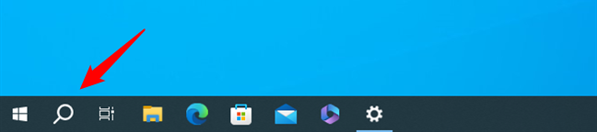
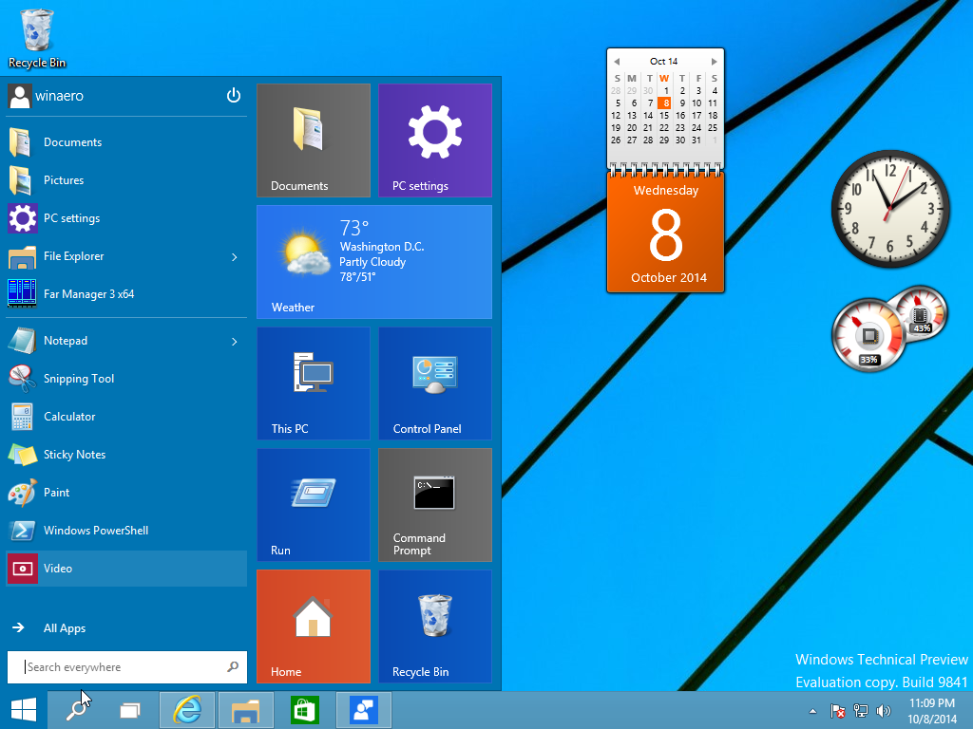
3. Taskbar
Description: The taskbar is a long horizontal bar typically at the bottom of the screen.
Components:
Start Button: Opens the Start menu, where you can access applications, settings, and files.
Quick Launch Icons: Shortcuts to frequently used applications.
Open Applications: Displays icons for currently running applications and windows.
System Tray: Contains the clock, volume control, network status, and other system icons.
Function: It helps you manage and switch between open applications and provides access to system functions.
4. Gadgets (Widgets in Windows 11)
Description: Small applications that provide at-a-glance information or quick access to tools.
Examples:
Clock: Displays the current time.
Calendar: Shows the date and any scheduled events.
Weather: Provides current weather conditions and forecasts.
Function: Enhances productivity by providing useful information and tools directly on the desktop.

Slide 14
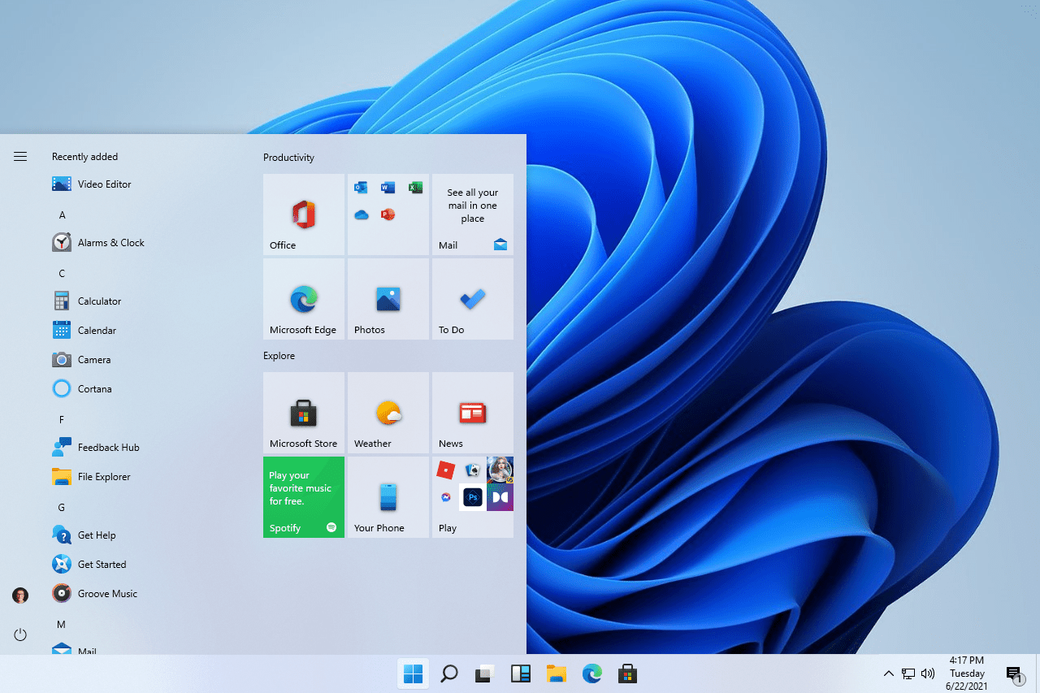
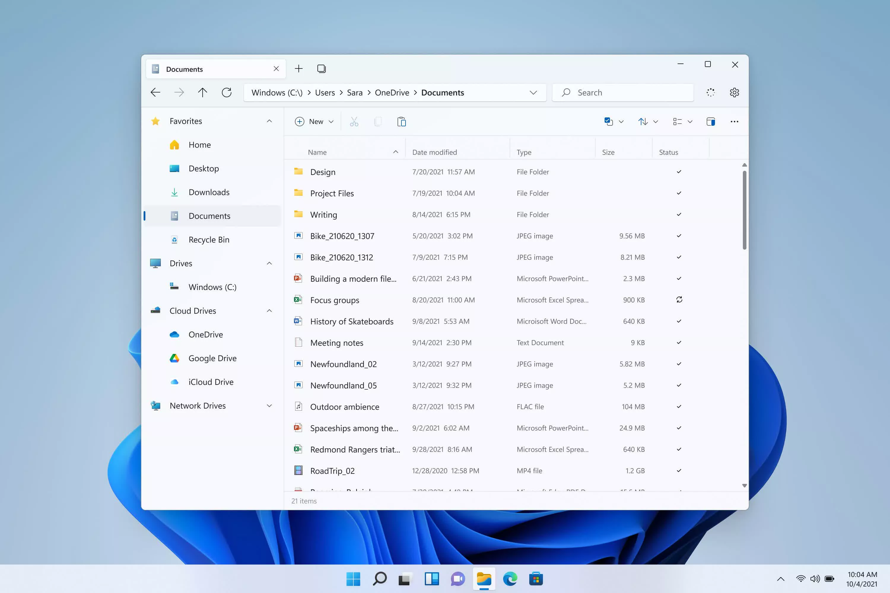
Additional Elements
5. Start Menu
Description: The main gateway to your computer's applications, settings, and files.
Components:
Pinned Apps: Quick access to frequently used applications.
All Apps List: A complete list of installed applications.
Power Options: Controls for shutting down, restarting, or putting the computer to sleep.
Function: It helps you find and launch applications, access settings, and manage power options.
6. File Explorer
Description: The file management tool in Windows.
Components:
Navigation Pane: Access to drives, folders, and libraries.
Content Area: Displays the contents of the selected drive or folder.
Function: It allows you to browse, organize, and manage files and folders

Slide 15
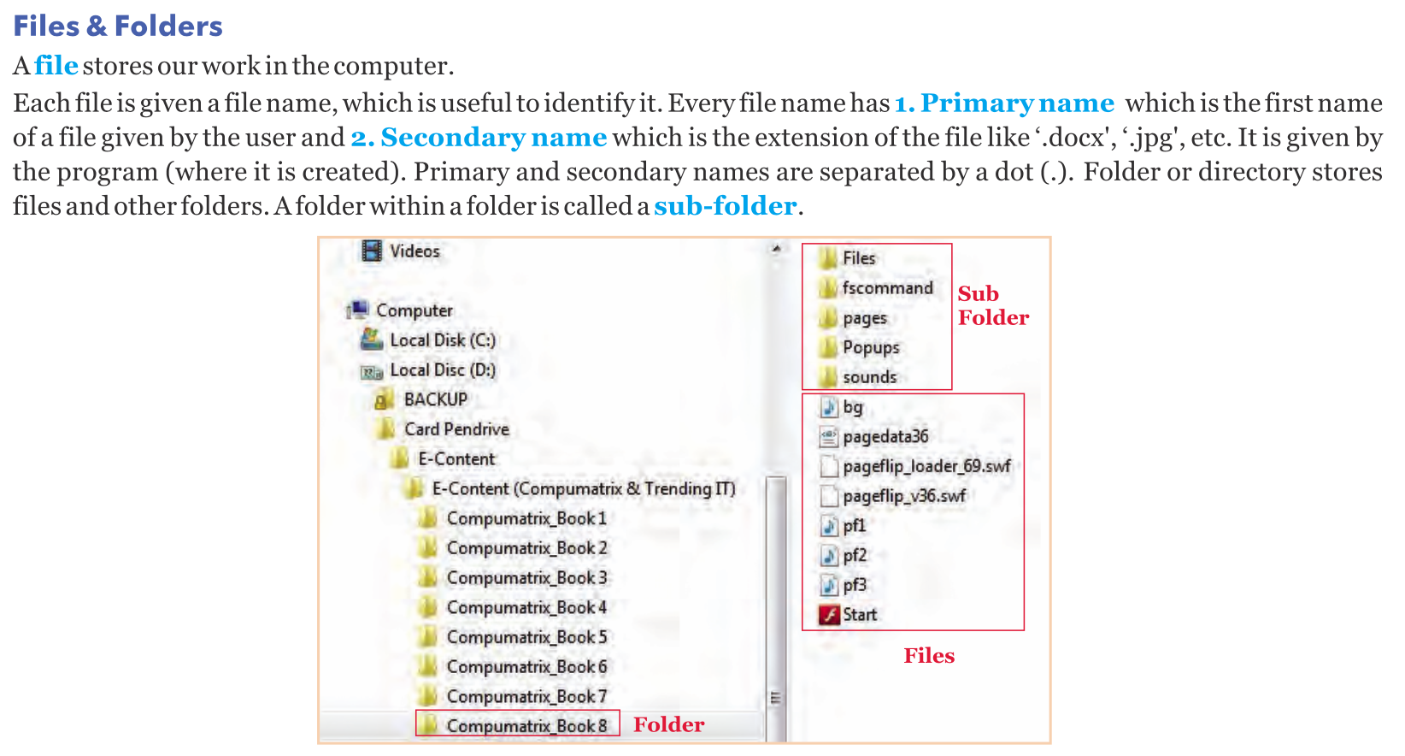

Slide 16
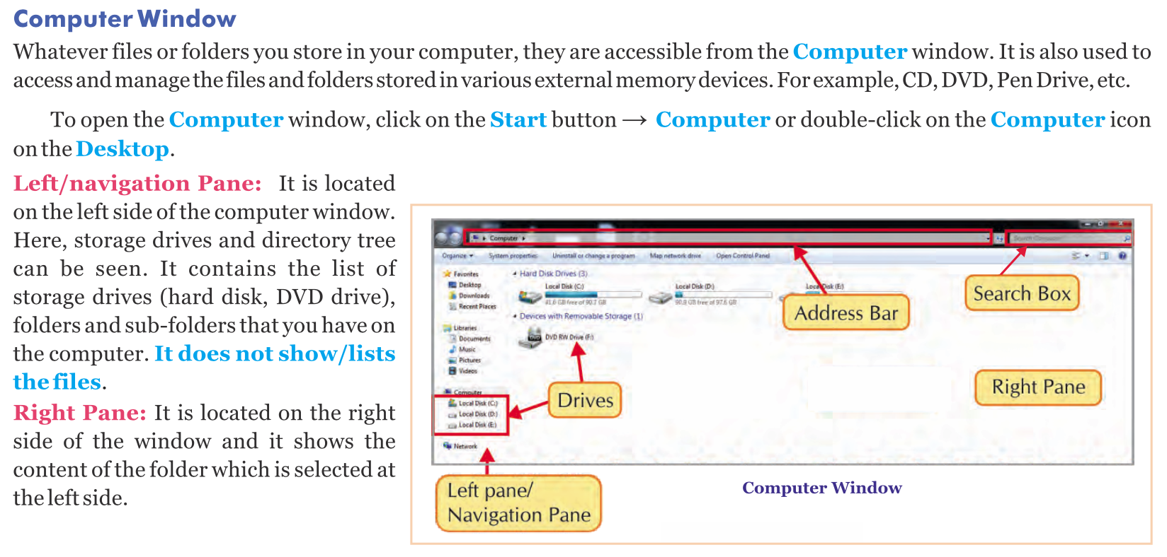

Slide 17
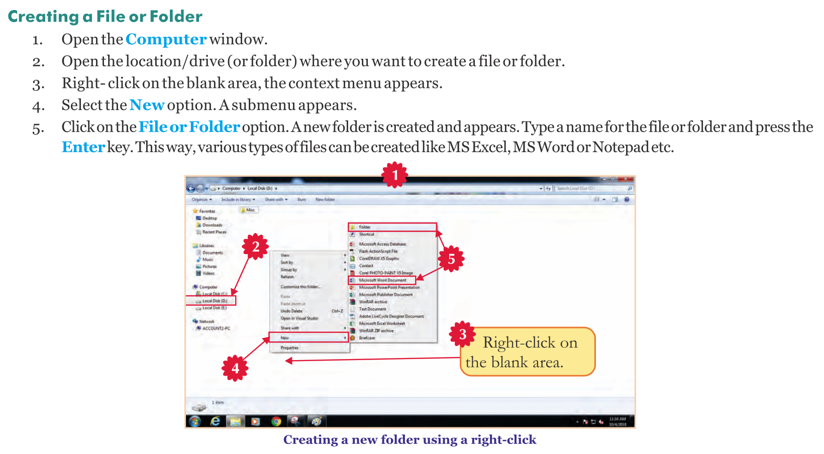

Slide 18
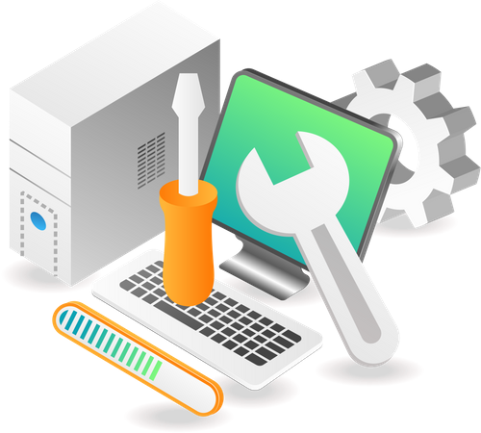
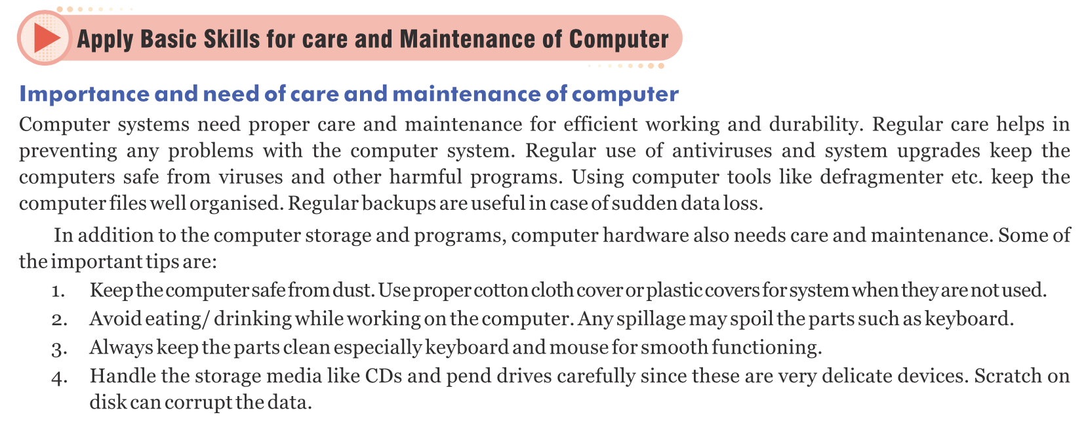

Slide 19
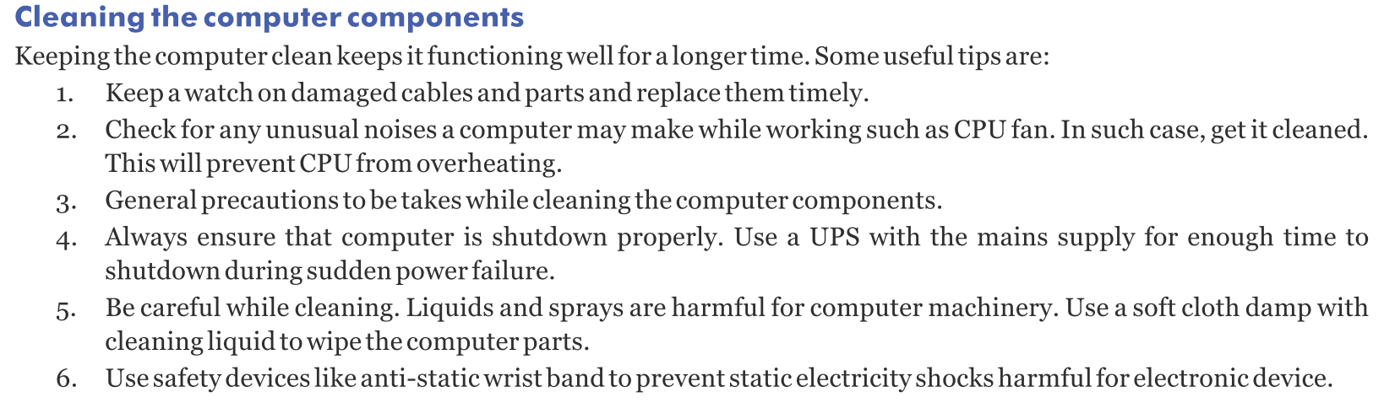

Slide 20
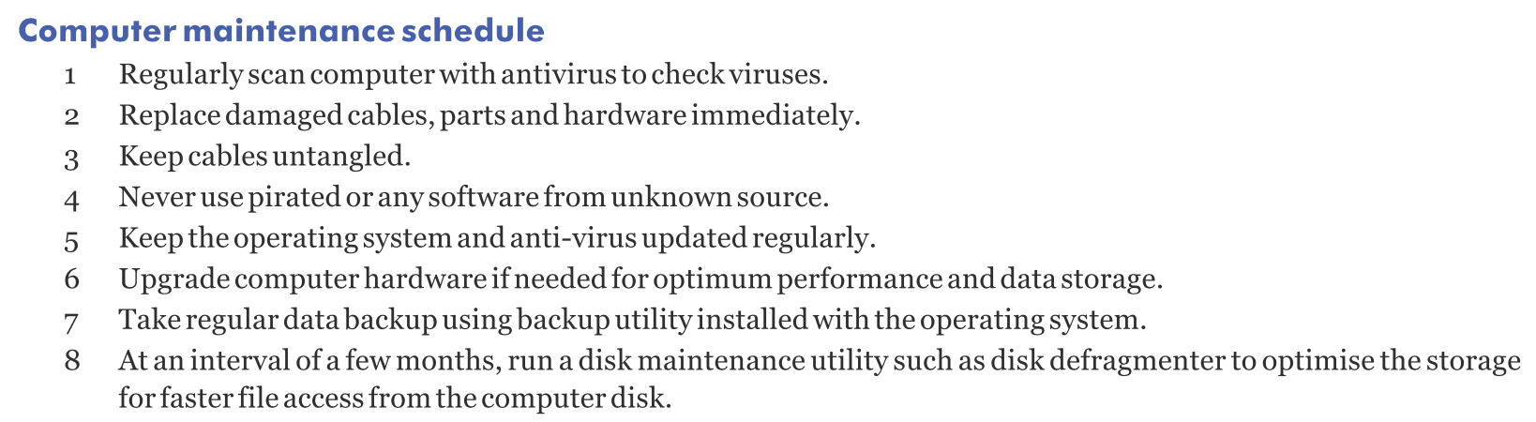

Slide 21
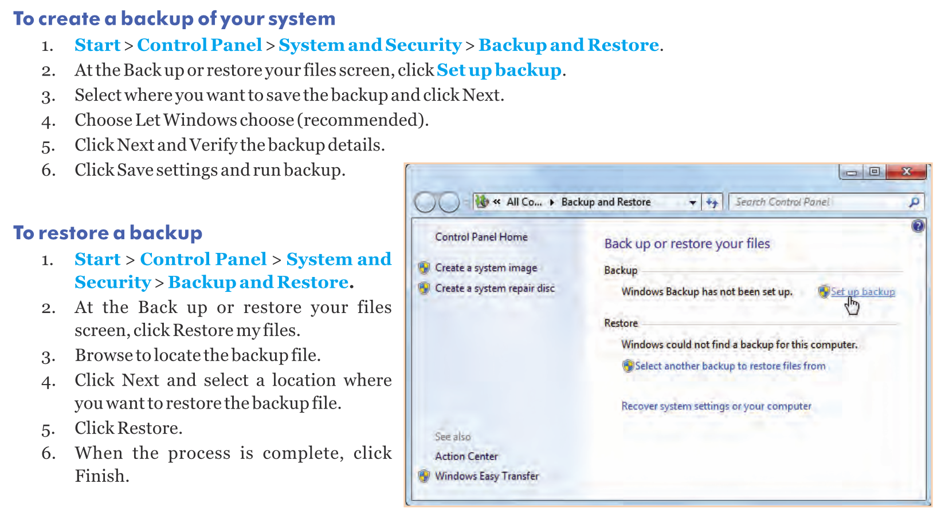

Slide 22
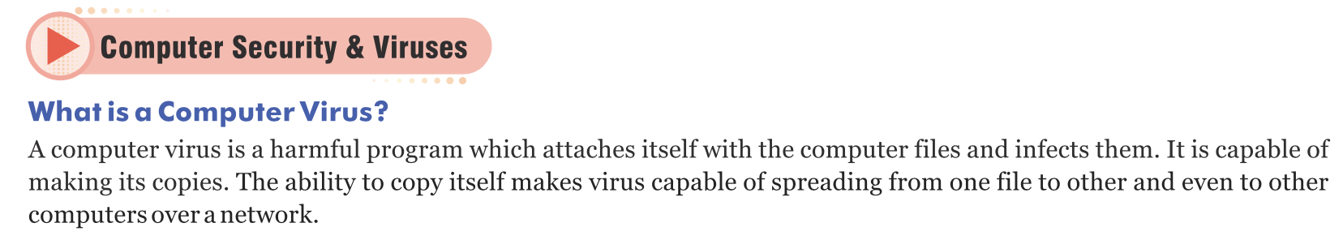
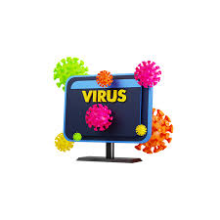
Types of Computer Viruses
1. File Infector Viruses
Description: These viruses attach themselves to executable files (such as .exe or .com files). When the infected file is run, the virus is activated.
Example: Cascade, which caused characters to fall down the screen.
2. Boot Sector Viruses
Description: These viruses infect the master boot record (MBR) of a hard drive or a removable storage device. They activate when the computer is booted from the infected disk.
Example: Michelangelo, which would activate on March 6 each year.

Slide 23
3. Macro Viruses
Description: These viruses target macro languages in applications like Microsoft Word or Excel. They are often spread through infected documents.
Example: Melissa, which spread through email attachments and infected Word documents.
4. Polymorphic Viruses
Description: These viruses change their code slightly each time they infect a new system, making them harder to detect by antivirus software.
Example: Storm Worm, which constantly changed its code to avoid detection.
5. Resident Viruses
Description: These viruses embed themselves in a computer’s memory and can execute whenever the operating system performs a specific function.
Example: Randex, which infected files and could spread to other computers over a network.

Slide 24
6. Direct Action Viruses
Description: These viruses are triggered when an infected file is executed. They do not stay in memory and do not affect the system when the file is not in use.
Example: Vienna virus, which deletes files when executed.
7. Multipartite Viruses
Description: These viruses can infect both the boot sector and executable files, making them more versatile and potentially more harmful.
Example: Tequila, which could spread through both file and boot sector infections.
8. Web Scripting Viruses
Description: These viruses exploit vulnerabilities in web browsers and websites. They can be embedded in web pages and execute when the page is viewed.
Example: JS/Exploit-BO, which could execute malicious scripts when a web page is loaded.

Slide 25
Malware
Description: Malware (short for malicious software) is any software intentionally designed to cause damage to a computer, server, or computer network.
Types:
Viruses: Malicious code that attaches to clean files and spreads to other files.
Worms: Standalone malware that replicates itself to spread to other computers.
Trojan Horses: Disguised as legitimate software but performs malicious actions once installed.
Spyware: Secretly monitors user activity and collects personal information.
Adware: Displays unwanted advertisements, often collecting data to target ads.
Ransomware: Encrypts the victim's data and demands a ransom for the decryption key.
Example: WannaCry, a ransomware that spread globally in 2017.

Slide 26
Phishing
Description: A type of online scam where attackers impersonate legitimate organizations or individuals to trick users into providing sensitive information, such as passwords or credit card numbers.
Methods:
Email Phishing: Fake emails that appear to be from trusted sources, asking users to click on malicious links or provide personal information.
Spear Phishing: Targeted phishing attacks aimed at specific individuals or organizations.
Whaling: Phishing attacks targeting high-profile individuals like executives or celebrities.
Example: An email pretending to be from a bank, asking you to confirm your account details by clicking on a link that leads to a fake website.

Slide 27
Other Cybersecurity Threats
1. Spyware
Description: Software that secretly gathers information about a person or organization without their knowledge.
Function: Monitors user activity, collects personal information, and can sometimes alter system settings.
Example: Keyloggers that record every keystroke made on a computer.
2. Adware
Description: Software that automatically displays or downloads advertising material when a user is online.
Function: Often bundled with free software and can be intrusive and annoying.
Example: Pop-up ads that appear when browsing the web.
3. Ransomware
Description: Malware that locks users out of their systems or encrypts their files and demands payment for access or decryption.
Function: Extorts money from victims by holding their data hostage.
Example: CryptoLocker, which encrypted users' files and demanded a ransom to decrypt them.

Slide 28
4. Trojan Horse
Description: Malware disguised as legitimate software that performs malicious activities once installed.
Function: Can open backdoors, steal information, or allow other malware to enter the system.
Example: Zeus, which stole banking information by logging keystrokes.
5. Worms
Description: Self-replicating malware that spreads without user interaction, often exploiting network vulnerabilities.
Function: Can spread rapidly across networks, causing widespread damage and disruption.
Example: Conficker, which infected millions of computers worldwide.

Slide 29
Protection and Prevention
Antivirus Software: Install and regularly update antivirus software to detect and remove malware.
Email Caution: Be wary of unexpected emails, especially those asking for personal information or containing links and attachments.
Strong Passwords: Use strong, unique passwords for different accounts and enable two-factor authentication.
Regular Updates: Keep your operating system and software up to date to protect against vulnerabilities.
Education: Stay informed about common threats and safe online practices.

Slide 30
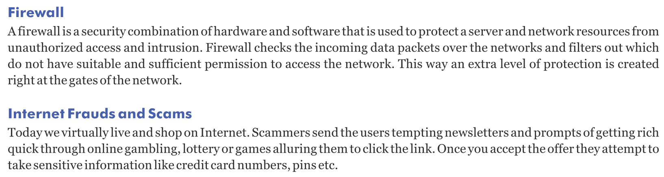
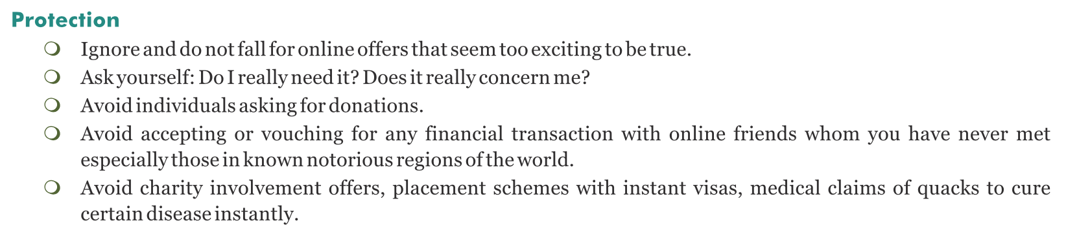

Slide 32
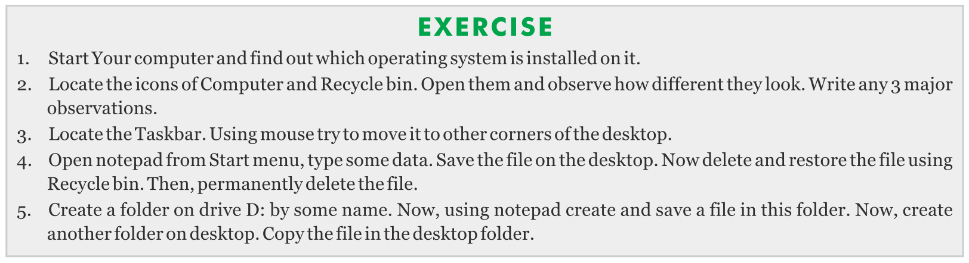

Slide 33
State whether True / False:
1. The wallpaper on a Windows desktop can be customized to any image chosen by the user.
2. Icons on the desktop are small graphical representations of applications, files, or folders.
3. The taskbar on a Windows desktop is always located at the bottom of the screen and cannot be moved.
4. The Start button on the taskbar provides access to applications, settings, and files.
5. Gadgets (widgets in Windows 11) on the Windows desktop are used to enhance productivity by providing quick access to useful tools.
6. The system tray on the taskbar displays the clock, volume control, network status, and other system icons.
7. File Explorer is the tool used to browse and manage files and folders on the Windows desktop.
8. In Windows, the desktop cannot display shortcuts to applications or files.
9. The desktop context menu, accessed by right-clicking on the desktop, allows users to personalize their desktop settings.
10. The Quick Launch icons on the taskbar provide shortcuts to frequently used applications.

Slide 34
Fill in the blank with appropriate answers given:
1.The main function of an operating system is to manage __________.
a) Hardware b) software
2.__________ is an example of an open-source operating system.
a) Windows b) Linux
3.The __________ provides a graphical interface to interact with the computer.
a) Desktop b) BIOS
4.In Windows, the long horizontal bar typically at the bottom of the screen is called the __________.
a) Taskbar b) sidebar
5.__________ is a type of operating system that allows multiple users to access the computer simultaneously.
a) Single-user OS b) Multi-user OS
6.A __________ is a small program that provides at-a-glance information and quick access to tools on the desktop.
a) gadget (widget in Windows 11) b) virus
7.The background image on your desktop is known as the __________.
a) Wallpaper b) screensaver
8.__________ is a type of malicious software designed to damage or disrupt a computer system.
a) Malware b) Firewall
9.An operating system that is used primarily on Apple computers is __________.
a) macOS b) Android
10.A __________ virus attaches itself to executable files and spreads to other files when the infected file is run.
a) file infector b) boot sector

Slide 35
